Slide 1
What do you know about Area???
Fun with Surfaces

Slide 2
So what DO you know about Area??
How would you find the area of this shape??
3 ft
17 ft
The area of a rectangle is found by multiplying it’s length by it’s width.
17 ft x 3 ft = 51 square feet

Slide 3
So what DO you know about Area??
How about this shape??
3 ft
34 ft
The area of a triangle is found by multiplying it’s base by it’s height and dividing the result by 2
The base and the height will always form a right angle.
$\frac{34(3)}{2}$ = 51 square feet

Slide 4
So what DO you know about Area??
How will this change things??
The area here is unaffected. The base and the height are the same.
3 ft
The base of the triangle may have to be extended to create a right angle with the height..
34 ft
$\frac{34(3)}{2}$ = 51 square feet

Slide 5
So what DO you know about Area??
What is this shape? How would you find it’s area?
This is a parallelogram. Both sets of sides are parallel to each other.
This is really a trick question…right now we don’t have enough information to find the area. But how would we?
3 ft
4 ft
What if we cut up our shape into smaller shapes?
17 ft
Now if we rearrange our shapes a bit…..
But we still need a figure for our height…
OK, now it’s evident…it’s like a rectangle where the length is the base, and the width is the ____________
$$A=17 ft ∗3 ft=51 square feet$$
height

Slide 6
So what DO you know about Area??
I’m sure you won’t be trapped by this one. Name it!
11 ft
This is a TRAPEZOID.
It has one set of parallel sides, called bases. The other set of sides are known as the legs.
10 ft
$2\sqrt{13}$ ft
There is more than one way to find the area of this shape. One way is to cut up the shape into more manageable shapes and then add them together.
8 ft
But we are lacking some values. How would we find the height of this shape?

Slide 7
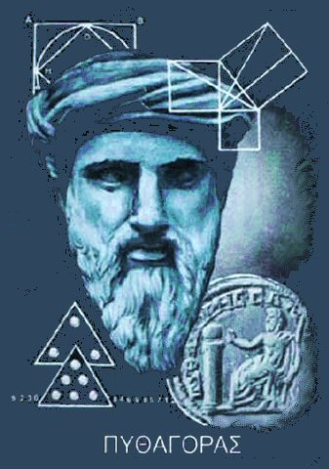
So what DO you know about Area??
Pythagoras, Pythagoras, He’s our Man!!!
Actually, what Pythagoras is probably most famous for…his Pythagorean theorem, was most likely discovered and proven many years prior, in many parts of the world. It’s an extraordinary useful tool:
In a right triangle, if the legs are labeled a and b, and the hypotenuse is labeled c
Then the relationship between these lengths is: $a^{2}+b^{2}=c^{2}$
c
a
So, if we know any two of these lengths, we can calculate the third!
b

Slide 8
So what DO you know about Area??
I’m sure you won’t be trapped by this one. Name it!
11 ft
Looking at the triangle on the right of the figure, we can use it to determine the height of our figure.
$a^{2}+b^{2}=c^{2}$
10 ft
6 ft
6 ft
$2\sqrt{13}$ ft
$8^{2}+b^{2}={10}^{2}$
$b^{2}=$ 36
$b=$ 6
8 ft
11 ft
4 ft
Now let’s find the missing piece of the last triangle, using the Pythagorean Theorem again.
Now we’re equipped to calculate the area:
Left Triangle:
$A= \frac{6∗8}{2}$
$$= 24 square feet$$
$6^{2}+b^{2}={\left(2\sqrt{13}\right)}^{2}$
Rectangle:
$A=6∗11$
$$= 66 square feet$$
$A= \frac{4∗6}{2}$
$b^{2}=$ 16
Right Triangle:
$$= 12 square feet$$
$b=$ 4
TOTAL AREA:
$$=102 square feet$$

Slide 9
So what DO you know about Area??
Now let’s consider another way of thinking about it…
11 ft
What if we chopped off a lower piece of the triangle and replace it in an upper (empty) area…?
10 ft
6 ft
6 ft
$2\sqrt{13}$ ft
Now how would we find the area of the resulting rectangle?
A = l*w
height
8 ft
11 ft
4 ft
The width is easy…it’s the _________ of the trapezoid!
Now we’re equipped to calculate the area:
The length of the rectangle is something between the top base and the bottom base.
$A = l∗w$ becomes $A=\frac{B_{1}+B_{2}}{2}∗h$
$$A=\frac{11+23}{2}∗6$$
In fact, it is the AVERAGE of the two bases.
$$=102 square feet$$

Slide 10
So what DO you know about Area??
Use what you have learned thus far to find the area of this figure.
13”
This figure can be cut into pieces (there are many ways this can be done) and the area calculated. The figure is symmetric with a vertical axis of symmetry right down the middle.
24”
7”
7”
12”
10”
7”
7”

Slide 11
So what DO you know about Area??
So we’ve discussed how to find the area of several types of figures, but what common shape has been conspicuously absent?.
The area of a circle is found by the equation $A =πr^{2}$
24”
So this circle has an area of $A =π{\left(6\right)}^{2}=36π$ square inches
Or approximately $113.1$square inches

Slide 12
So what DO you know about Area??
How can we use that to find these areas?
12”
$$79°$$
16”
38”
8”
$$60°$$
$$A =\frac{79}{360}\left(π{∗16}^{2}\right) sq in$$
$$A =\frac{2528}{45}π≈176.5 sq in$$
$$A =\frac{1}{2}\left(π{∗19}^{2}\right) sq in$$
$$A =\frac{3}{4}\left(π{∗8}^{2}\right) sq in$$
$$A =\frac{5}{6}\left(π{∗12}^{2}\right) sq in$$
$$A = \frac{361}{2}π≈567.1 sq in$$
$$A =48π≈150.8 sq in$$
$$A =120π≈377.0 sq in$$

Slide 13
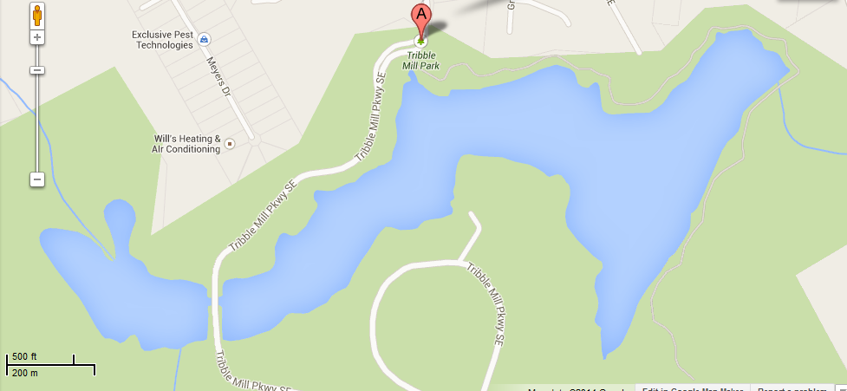
So what DO you know about Area??
So now it gets interesting…
Gwinnett County has a problem in the larger of the two lakes at Tribble Mill Park. To treat the problem, they need to know the surface area of the lake.
Your task is to divide the lake into sections and find its total area. There are many correct ways to do this. Be careful in your calculations!
A
B
C
D
E
1
2
3
4
5
6
7
8
9
10
11

Slide 15
Title and Content Layout with Chart

Slide 16
Two Content Layout with Table
First bullet point here
Second bullet point here
Third bullet point here
 | Group A | Group B
Class 1 | 82 | 95
Class 2 | 76 | 88
Class 3 | 84 | 90

Slide 17
Two Content Layout with SmartArt
Task 1
Task 2
Task 3
Task 4
Task 5
First bullet point here
Second bullet point here
Third bullet point here

