Slide 1

Geometric Transformations
Notes:
.

Slide 2
Reflection, Rotation, Translation, or Dilation
Rotation
Notes:
Rotation

Slide 3
Reflection, Rotation, Translation, or Dilation
Reflection
Notes:
Reflection

Slide 4

Reflection, Rotation, Translation, or Dilation
Translation
Notes:
Translation

Slide 5
Reflection, Rotation, Translation, or Dilation
Dilation
Notes:
Translation

Slide 6
Reflection, Rotation, Translation, or Dilation
Notes:
Translation.

Slide 7
Reflection, Rotation, Translation, or Dilation
Notes:
Translation.

Slide 8
Reflection, Rotation, Translation, or Dilation
Notes:
Reflection. However, rotation of 180º will be the same.

Slide 9
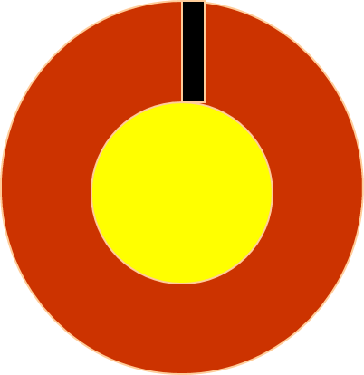
Reflection, Rotation, Translation, or Dilation
Notes:
Rotation

Slide 10

Look….transformations in the REAL WORLD
Notes:
Rotation

Slide 11

Look….transformations in the REAL WORLD
Notes:
Rotation

Slide 12
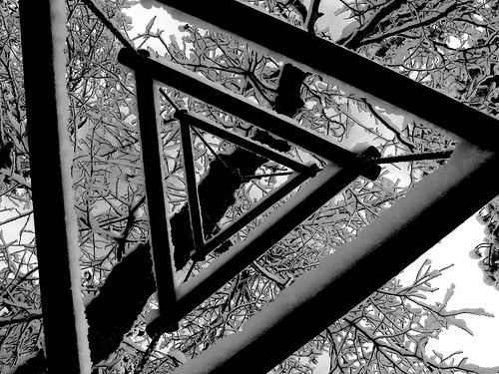
Look….transformations in the REAL WORLD
Notes:
Rotation

Slide 13
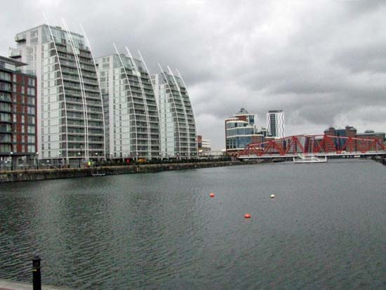
Look….transformations in the REAL WORLD
Notes:
Rotation

Slide 14

Look….transformations in the REAL WORLD
Notes:
Rotation

